Slide 1
CS 699 Final pROJECT
Dongzhen Wang
WeiLin Lu

Slide 2
InTRODUCTION
Data is an essential part of computer science, statistics, data analysis, and business analysis. More and more people are starting to work in the data analysis industry. Therefore, data mining is a must-learn technique for anyone who aspires to become a data analyst. Data mining refers to the process of searching for information hidden in a large amount of data through algorithms

Slide 3
Data mining is generally related to computer science and achieves these goals through several methods such as statistics, online analytical processing, intelligence retrieval, machine learning, expert systems (relying on past rules of thumb), and pattern recognition.
This data mining project finds whether there is a clear relationship between different data (purchase time, purchase quantity, indeed and customer gender) and the payment method chosen by the final customer through transaction data (excluding detailed transaction amount) of a website.

Slide 4

Goals
We build and train models based on the buyer's gender, items purchased, time of purchase, location of purchase, and buyer's payment method in the training data set. Then predict their payment method for the buyers in the test dataset. Our goal is to find the algorithm with the highest accuarcy

Slide 5
About Our dataset
Dataset of an Online Sales in USA is about the sales of different products, several merchandise and electronic in different states. Since a huge chunk of the people who have access to internet is switching to online shopping, large retailers are actively searching for ways to increase their profit. Sales analysis is one such key techniques used by large retailers to increase sales by understanding the customers' purchasing behavior & patterns. Market basket analysis examines collections of items to find relationships between items that go together within the business context.

Slide 6
Detailed description of the datasets
Our data set is the historical purchase records of customers from a shopping website. A total of 26 columns and 500 rows of data. It includes purchase time, status, purchase quantity, price, discount, total, year, month, day, transaction number, name, age, address information and payment method.These data include numeric data and categorical data. All we have to do is to clean the useless data out of the original data, and then mine the correlation between the different data retained and the payment method chosen by the end customer.

Slide 7
aTtributes
37 attributes and 286393 rows from Year 2020-2021
order_date
Status ( Canceled, Order Refunded, Complete, Received, Refund)
Quantity ordered
Price
Value
Discount amount
Total
Category( Mobiles&Tablets, Computing,Appliances,Fashions)
Year, Month
Name Prefix(Prof,Hon,Ms.Dr.)
Gender,Age, Full name
County, City, States, Zip, Region
Payment Methods (Paypal, Visa)

Slide 8
Tools to use
Google:Google's search engine
EXCEL:Excel is a spreadsheet software written by Microsoft for computers using Windows and Apple Macintosh operating systems. It allows users to easily operate various data tables (including csv)
WEKA:Weka's full name is Waikato Environment for Knowledge Analysis, which is a free, non-commercial (corresponding to SPSS company's commercial data mining product - Clementine), based on open source machine learning and data mining software in the JAVA environment .

Slide 9
Data Cleaning
Due to too many data columns, we used excel to manually delete some useless data, such as: order_id, cust_id, ref_num, SSN and other data. There are three different payment methods in the data, we value data mining for two payment methods. So we only keep visa and paypal (the most common payment method), and delete the third payment method from csv. Since the time to write python codes will be higher than directly using excel to operate csv files, we did not write python codes, and directly used excel to sort the payment methods and then deleted the third payment method.

Slide 10

Classification Algorithms
Classification is the one of the main technique that we have been learning throughout the semester, it also used for discovering the pattern from known classes. In our real life, we might be facing a data set that contains over hundred attributes, but not every single attribute is needed for us to complete the mining work. In order to determine which attribute is important, feature selections algorithms are utilized. Instead of processing all the attributes, only relevant attributes are involved in the mining process.

Slide 11
5 Classification Algorithms
Naïve Bayes
Logistic Regression
J48
Random Forest
Bagging

Slide 12
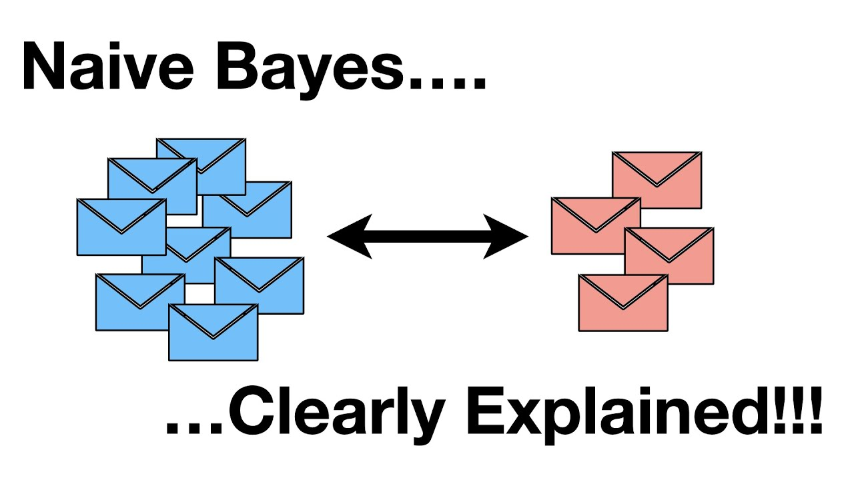
Naïve Bayes
Bayesian classification algorithm is a classification method in statistics, which is a class of algorithms that use the knowledge of probability and statistics to classify.
Easy Implementation
Probably one of the simplest, easiest to implement and most straight-forward machine learning algorithm.
Fast and Simple
Naive Bayes is not only simple but it's fast and simple which makes it a perfect candidate in certain situations. When you're looking for the least hyper parameters, but still very acceptable results Naive Bates algorithm may be the way to go.
Scaling Advantages
Naive Bayes scales linearly which makes it a great candidate for large setups
Noise Resilience
.
If your data has noise, irrelevant features, outlier values etc., no worries, Naive Bayes thrives in such situations and its prediction capabilities won't be seriously affected like some of the other algorithms

Slide 13
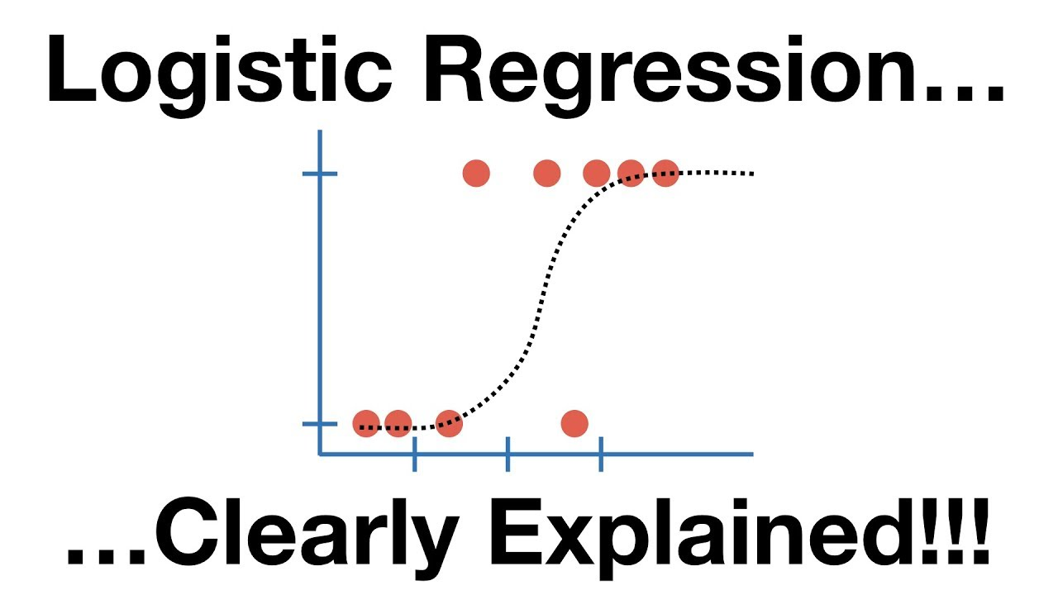
Logistic Regression
It is a generalized linear regression analysis model, which belongs to supervised learning in machine learning. The model is trained by given n sets of data (training set), and after training is completed, the given set or sets of data (test set) are classified. Each set of data is composed of p indicators
Logistic regression is easier to implement, interpret, and very efficient to train
It makes no assumptions about distributions of classes in feature space.
It not only provides a measure of how appropriate a predictor(coefficient size)is, but also its direction of association (positive or negative)

Slide 14

J48
This algorithm is a kind of decision tree. Based on top-to-bottom strategy, recursive divide-and-conquer strategy, select an attribute to place at the root node, generate a branch for each possible attribute value, divide the instance into multiple subsets, each subset corresponds to a branch of the root node , then recursively repeat the process on each branch. Stop when all instances have the same classification.
J48 can help not only to make accurate predictions from the data but also to explain the patterns in it. It deals with the problems of the numeric attributes, missing values, pruning, estimating error rates, complexity of decision tree induction, and generating rules from trees

Slide 15
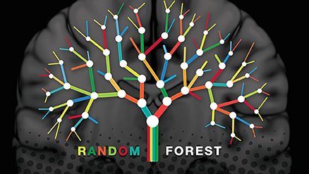
Random Forest
Random Forest is a classifier that uses multiple trees to train and predict samples.
Random Forests work well with both categorical and numerical data. No scaling or transformation of variables is usually necessary.
Implicitly perform feature selection and generate uncorrelated decision trees. It does this by choosing a random set of features to build each decision tree. This also makes it a great model when you have to work with a high number of features in the data.
Generally, provide high accuracy and balance the bias-variance trade-off well. Since the model’s principle is to average the results across the multiple decision trees it builds, it averages the variance as well

Slide 16
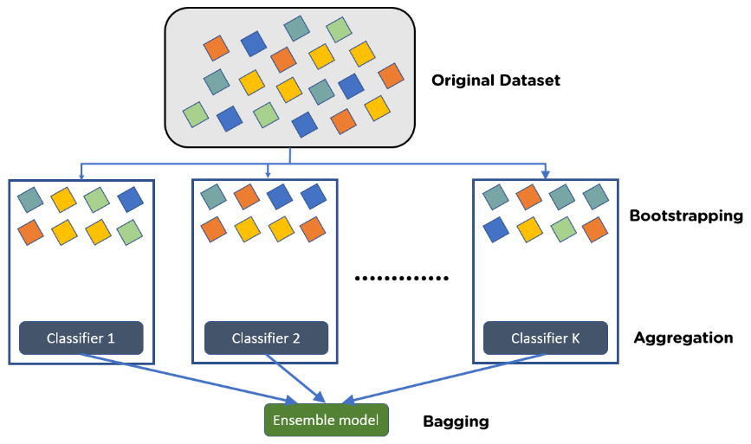
Bagging
The Bagging algorithm can be combined with other classification and regression algorithms to improve its accuracy and stability, and at the same time reduce the variance of the results to avoid over fitting.
Bagging offers the advantage of allowing many weak learners to combine efforts to outdo a single strong learner. It also helps in the reduction of variance, hence eliminating the overfitting of models in the procedure. One disadvantage of bagging is that it introduces a loss of interpretability of a model.

Slide 17

5 attribute selection methods
1.ClassifierAttributeEval:
2.RelifFAttributeEval
3.GainRatioAttributeEval
4. OneRAttributeEval
5. Correlation Attribute Eval

Slide 18
Data mining Progress
We use weka to divide the data set into two parts: training data set and testing data set. 66% of the original data is the training set and 34% is the test set.
We first train the training data set based on five basic algorithms, and predict the accuracy of the test data set. Then based on the five attribute selection methods, re-run the five algorithms we selected to train the training data set and predict the test data set to obtain a new accuracy rate. We compare the new and old accuracy rates to find the attribute and algorithm with the highest accuracy rate.

Slide 19
Accuracy(5 algorithm only)
Naïve Bayes: 90 %
Logistic: 91%
J48: 94%
Random Forest:96.4%
Bagging:94.8%

Slide 20
Accuracy(Attributes selected)
ClassifierAttributeEval:
Naïve Bayes:87.5758%
Logistic: 87.5758%
J48: 95.4545%
Random Forest:97.2727%
Bagging:95.1515%
RelifFAttributeEval:
Naïve Bayes:86.3636%
Logistic: 94.4242%
J48: 93.9394%
Random Forest:96.0606%
Bagging:94.8485%

Slide 21
Accuracy(Attributes selected)
OneRAttributeEval:
Naïve Bayes:90%
Logistic: 92.4242%
J48: 92.4242%
Random Forest:94.5455%
Bagging:94.5455%
CorrelationAttributeEval:
Naïve Bayes:89.697%
Logistic: 91.5152%
J48: 94.2424%
Random Forest:95.4545%
Bagging:94.8485%

Slide 22
Accuracy(Attributes selected)
GainRatioAttributeEval:
Naïve Bayes:83.0303%
Logistic: 86.0606%
J48: 91.2121%
Random Forest:93.6364%
Bagging:90.9091%

Slide 23
CONCLUSION
Summing the above data and accuracy, it can be found that Random Forest based on ClassifierAttributeEval has the highest data accuracy. We can also conclude that even with the same Attribute, using different algorithms can have a huge impact on the results. Therefore, when mining data, it is necessary to conduct multiple experiments to ensure that the best data model is obtained, so as to obtain the most correct data results.

